Slide 1

PYTHON PROGRAMMING & DATA SCIENCE
Backpropagation

Slide 2
Backpropagation
Why We Need Backpropagation?
While designing a Neural Network, in the beginning, we initialize weights with some random values.
So, it’s not necessary that whatever weight values we have selected will be correct, or it fits our model the best.
we have selected some weight values in the beginning, but our model output is way different than our actual output i.e. the error value is huge.
To reduce the error we need to somehow explain the model to change the parameters (weights), such that error becomes minimum.

Slide 3
Backpropagation
What is backpropagation?
It was first introduced in the 1960s and 30 years later it was popularized by David Rumelhart, Geoffrey Hinton, and Ronald Williams in the famous 1986 paper.
Neural network training happens through backpropagation. By this approach, we fine-tune the weights of a neural net based on the error rate obtained in the previous run.
The right manner of applying this technique reduces error rates and makes the model more reliable.
Backpropagation is used to train the neural network of the chain rule method. In simple terms, after each feed-forward passes through a network, this algorithm does the backward pass to adjust the model’s parameters based on weights and biases.
Backpropagation works with a multi-layered neural network and learns internal representations of input to output mapping.

Slide 4
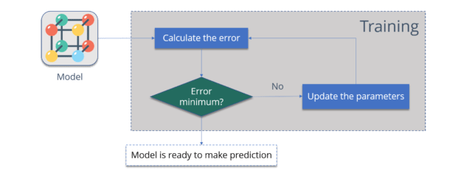
Backpropagation
Consider the diagram below:
Calculate the error :
How far is your model output from the actual output.
Minimum Error :
Check whether the error is minimized or not.
Update the parameters :
If the error is huge then, update the parameters (weights and biases). After that again check the error. Repeat the process until the error becomes minimum.
Model is ready to make a prediction :
Once the error becomes minimum, you can feed some inputs to your model and it will produce the output.

Slide 5
Backpropagation
How does backpropagation work?
Let us take a look at how backpropagation works. It has four layers: input layer, hidden layer, hidden layer II and final output layer
So, the main three layers are:
Input layer
Hidden layer
Output layer
Each layer has its own way of working and its own way to take action such that we are able to get the desired results and correlate these scenarios to our conditions. Let us discuss other details needed to help summarizing this algorithm.

Slide 6
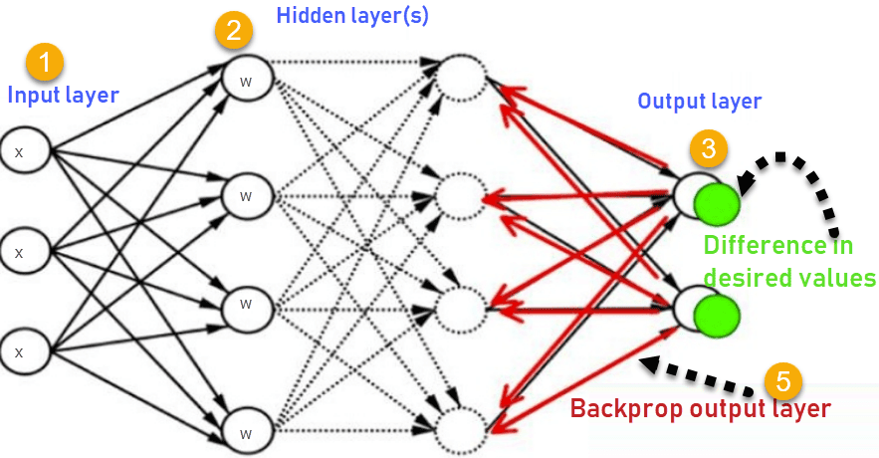
Backpropagation
This image summarizes the functioning of the backpropagation approach.
Input layer receives x
Input is modeled using weights w
Each hidden layer calculates the output and data is ready at the output layer
Difference between actual output and desired output is known as the error
Go back to the hidden layers and adjust the weights so that this error is reduced in future runs
This process is repeated till we get the desired output. The training phase is done with supervision. Once the model is stable, it is used in production.

Slide 7
Backpropagation
Types of backpropagation
There are two types of backpropagation networks.
Static backpropagation
Recurrent backpropagation
Static backpropagation
In this network, mapping of a static input generates static output. Static classification problems like optical character recognition will be a suitable domain for static backpropagation.
Recurrent backpropagation
Recurrent backpropagation is conducted until a certain threshold is met. After the threshold, the error is calculated and propagated backward.
The difference between these two approaches is that static backpropagation is as fast as the mapping is static.

Slide 8
Backpropagation
Advantages:
Backpropagation has many advantages, some of the important ones are listed below-
Backpropagation is fast, simple and easy to implement
There are no parameters to be tuned
Prior knowledge about the network is not needed thus becoming a flexible method
This approach works very well in most cases
The model need not learn the features of the function

Slide 9
Backpropagation
Disadvantages of backpropagation
Input data holds the key to the overall performance
Noisy data can lead to inaccurate results
Matrix based approach is preferred over a mini-batch

Slide 10
Backpropagation
Example:
Consider Iris data which contains features such as length and width of sepals and petals. With the help of those, we need to identify the species of a plant.
For this, we will build a multilayered neural network and will use the sigmoid function as it is a classification problem.

Slide 11
Backpropagation
Let us read the libraries required and read the data..
import numpy as np
import pandas as pd
import seaborn as sns
import matplotlib.pyplot as plt
from sklearn.model_selection import train_test_split

Slide 12
Backpropagation
To ignore warnings, we will import another library called warnings.
import warnings
warnings.simplefilter(action='ignore', category=FutureWarning)

Slide 13
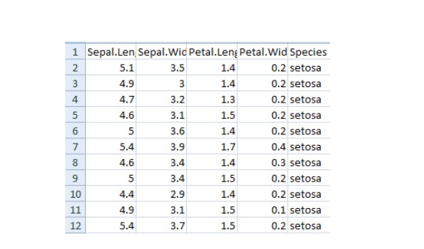
Backpropagation
Let us now read the data
iris = pd.read_csv("iris.csv")
iris.head()

Slide 14
Backpropagation
Now we will put labels to the class as 0,1 and 2.
iris['Species']. replace (['setosa', 'virginica', 'versicolor'], [0, 1, 2], inplace=True)
We will now define functions which will do the following.
Perform one hot encoding to the output.
Perform sigmoid function
Normalize the features.

Slide 15
Backpropagation
For one hot encoding, we define the following function.
def to_one_hot(Y):
n_col = np.amax(Y) + 1
binarized = np.zeros((len(Y), n_col))
for i in range(len(Y)):
binarized [i, Y[i]] = 1.
return binarized
Let us now define a sigmoid function
def sigmoid_func(x):
return 1/(1+np.exp(-x))
def sigmoid_derivative(x):
return sigmoid_func(x)*(1 – sigmoid_func(x))

Slide 16
Backpropagation
Now we will define a function for normalization
def normalize (X, axis=-1, order=2):
l2 = np. atleast_1d (np.linalg.norm(X, order, axis))
l2[l2 == 0] = 1
return X / np.expand_dims(l2, axis)

Slide 17
Backpropagation
Now we will apply normalization to the features and one hot encoding to the output
columns = ['Sepal.Length', 'Sepal.Width', 'Petal.Length', 'Petal.Width']
x = pd.DataFrame(iris, columns=columns)
x = normalize(x.as_matrix())
columns = ['Species']
y = pd.DataFrame(iris, columns=columns)
y = y.as_matrix()
y = y.flatten()
y = to_one_hot(y)

Slide 18
Backpropagation
Now it’s time to apply back propagation. To do that, we need to define weights and a learning rate. Let us do that. But before that we need to split the data for training and testing.
#Split data to training and validation data
X_train, X_test, y_train, y_test = train_test_split(x, y, test_size=0.33)
#Weights
w0 = 2*np.random.random((4, 5)) - 1 #for input - 4 inputs, 3 outputs
w1 = 2*np.random.random((5, 3)) - 1 #for layer 1 - 5 inputs, 3 outputs
#learning rate
n = 0.1

Slide 19
Backpropagation
We will set a list for errors and see how the change in training decreases the error via visualization.
errors = []
Let us perform the feed forward and back propagation network.
For backpropagation, we will use gradient descent.

Slide 20
Backpropagation
for i in range (100000):
Feed forward network
layer0 = X_train
layer1 = sigmoid_func(np.dot(layer0, w0))
layer2 = sigmoid_func(np.dot(layer1, w1))
Back propagation using gradient descent
layer2_error = y_train - layer2
layer2_delta = layer2_error * sigmoid_derivative(layer2)
layer1_error = layer2_delta.dot (w1.T)
layer1_delta = layer1_error * sigmoid_derivative(layer1)
w1 += layer1.T.dot(layer2_delta) * n
w0 += layer0.T.dot(layer1_delta) * n
error = np.mean(np.abs(layer2_error))
errors.append(error)

Slide 21
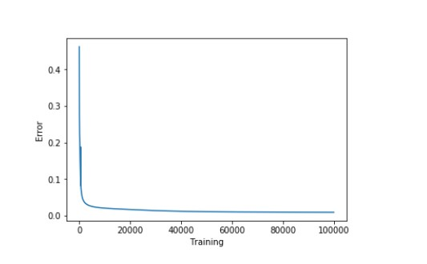
Backpropagation
Accuracy will be gathered and visualized by subtracting the error from the training data
accuracy_training = (1 - error) * 100
Now let us visualize how accuracy increases by decreasing the error
plt.plot(errors)
plt.xlabel('Training')
plt.ylabel('Error')
plt.show()

Slide 22
Backpropagation
Let us look at the accuracy now
print ("Training Accuracy of the model " + str (round(accuracy_training,2)) + "%")
Output: Training Accuracy of the model 99.04%

Slide 23
Backpropagation
Our training model is performing really well. Now let us see the validation accuracy.
#Validate
layer0 = X_test
layer1 = sigmoid_func(np.dot(layer0, w0))
layer2 = sigmoid_func(np.dot(layer1, w1))
layer2_error = y_test - layer2
error = np.mean(np.abs(layer2_error))
accuracy_validation = (1 - error) * 100
print ("Validation Accuracy of the model “+ str(round(accuracy_validation,2)) + "%")
Output: Validation Accuracy 92.86%
The performance was as expected.

Slide 24
THANK YOU

